Slide 1
Learning Big Data
Aditya Konda
Big Data Engineer

Slide 2
Content
Yarn
Resource Manager
Node Manager
Application Startup
Application Startup Process

Slide 3
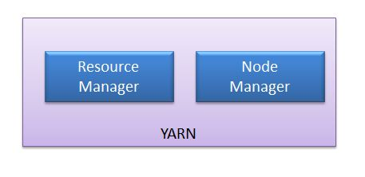
YARN
YARN - Yet Another Resource Negotiator, Improves Cluster Utilization
A framework responsible for providing the computational resources (CPUs, memory, etc)
Nodes have resources which are allocated to application when requested
Supports MR and non-MR applications
Two important elements
Resource Manager
Node Manager

Slide 4
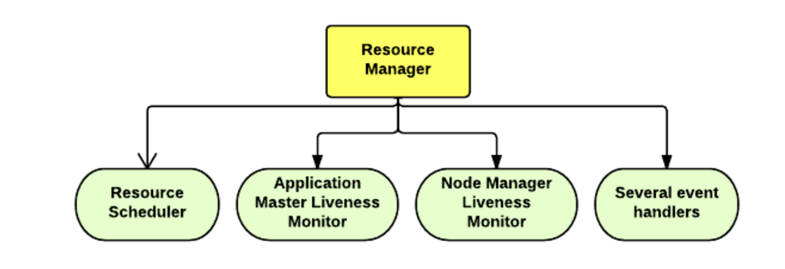
YARN – Resource Manager
One per cluster – resides on Master Node
It knows where the slaves are located and also it resources
Resource Manger Responsibilities
Resource Scheduler
Application Master Liveness Monitor
Node Manger Liveness Monitor
Several Event Handlers

Slide 5
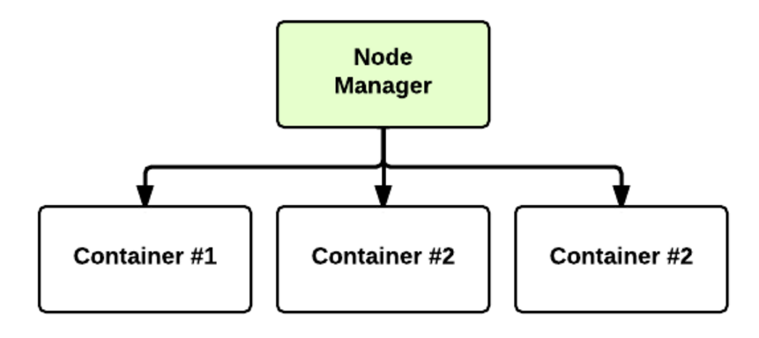
YARN – Node Manager
Many in a cluster – resides on Slave Nodes/ Worker Nodes
Periodically sends heartbeat to the Resource Manager
Offers some resources to the cluster
At run-time, the Resource Scheduler will decide how to use this capacity (Containers)

Slide 6
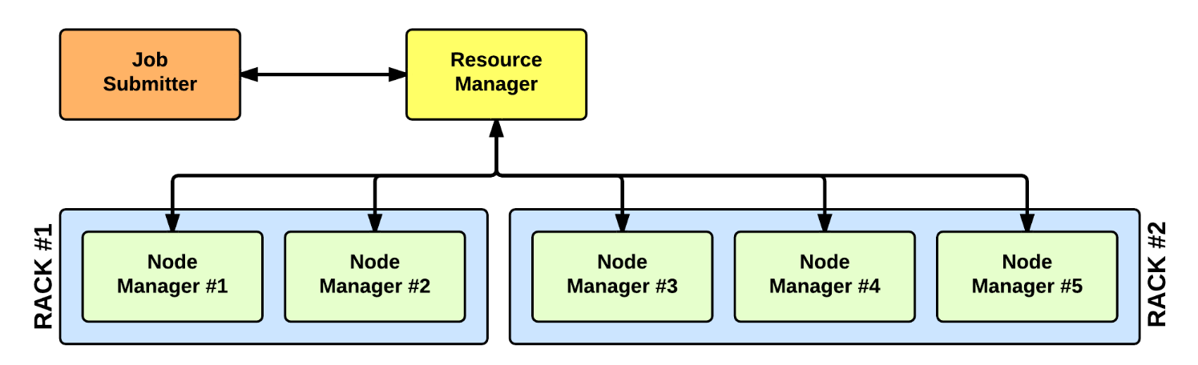
YARN – Application Startup
In YARN, there are at least three actors:
The Job Submitter (the client)
The Resource Manager (the master)
The Node Manager (the slave)

Slide 7
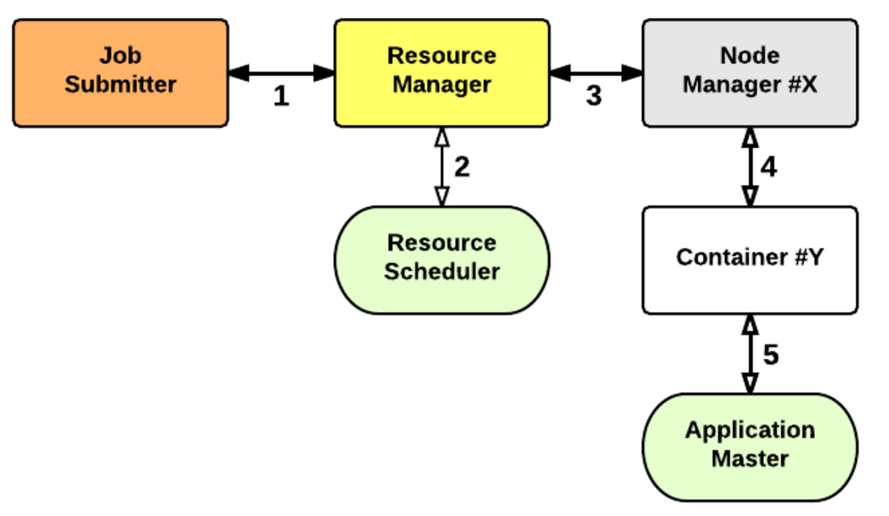
YARN - Application Startup Process
Application Manager: Responsible for the execution of a single application
Workflow of an YARN

Slide 8
References
Introduction to Yarn and MR by cloudera
Yarn Architecture
Difference between Hadoop 1.x and Hadoop 2.x (in-terms of yarn)

Slide 9


